Slide 1

SLGPT
Sign Language based GPT An ML based tool for the differently abled
- Sujit Suresh, BTech ECE

Slide 2
PROBLEM STATEMENT
The World Health Organization stated that approximately 70 million people in the world are deaf-mutes (Both deaf and mute).
Currently more than 1.5 billion people (nearly 20% of the global population) live with hearing loss. A total of 430 million people are deaf, about 5% of the world’s population.
The project addresses the communication barrier faced by the deaf, mute and hard-of-hearing community by creating a Machine Learning-based Sign Language Understanding Chatbot (SLUC).

Slide 3
Implementation method
This model is predominantly built in python and utilize python’s vast number of libraries
The model is initially trained through computer vision and Mediapipe ML library, different signs in sign languages and associates them with a label.
Once trained the model is sent through feed forward sequential Neural where it is trained to associate certain movement with those labels and learn to understand it in real time.

Slide 4
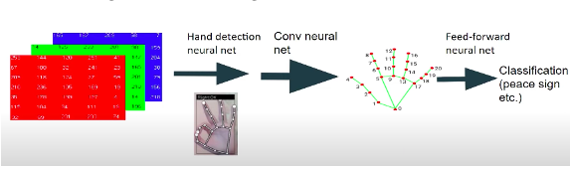
fLOW CHART OF THE MODEL

Slide 5
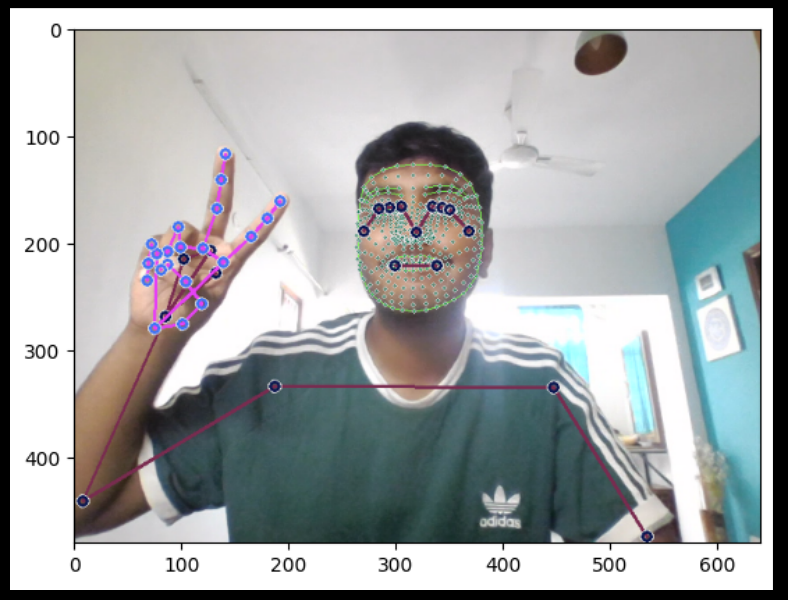
mEDIAPIPE
The model uses MediaPipe holistic function, which is able to simultaneously estimate multiple aspects of the human body, including:
Face Landmarks: It can detect and track facial landmarks like eyes, nose, and mouth.
Hand Landmarks: It can estimate the landmarks of the hand, allowing for hand gesture recognition.
Body Pose: It can track the key points of the human body, such as shoulders, elbows, hips, knees, and ankles.

Slide 6
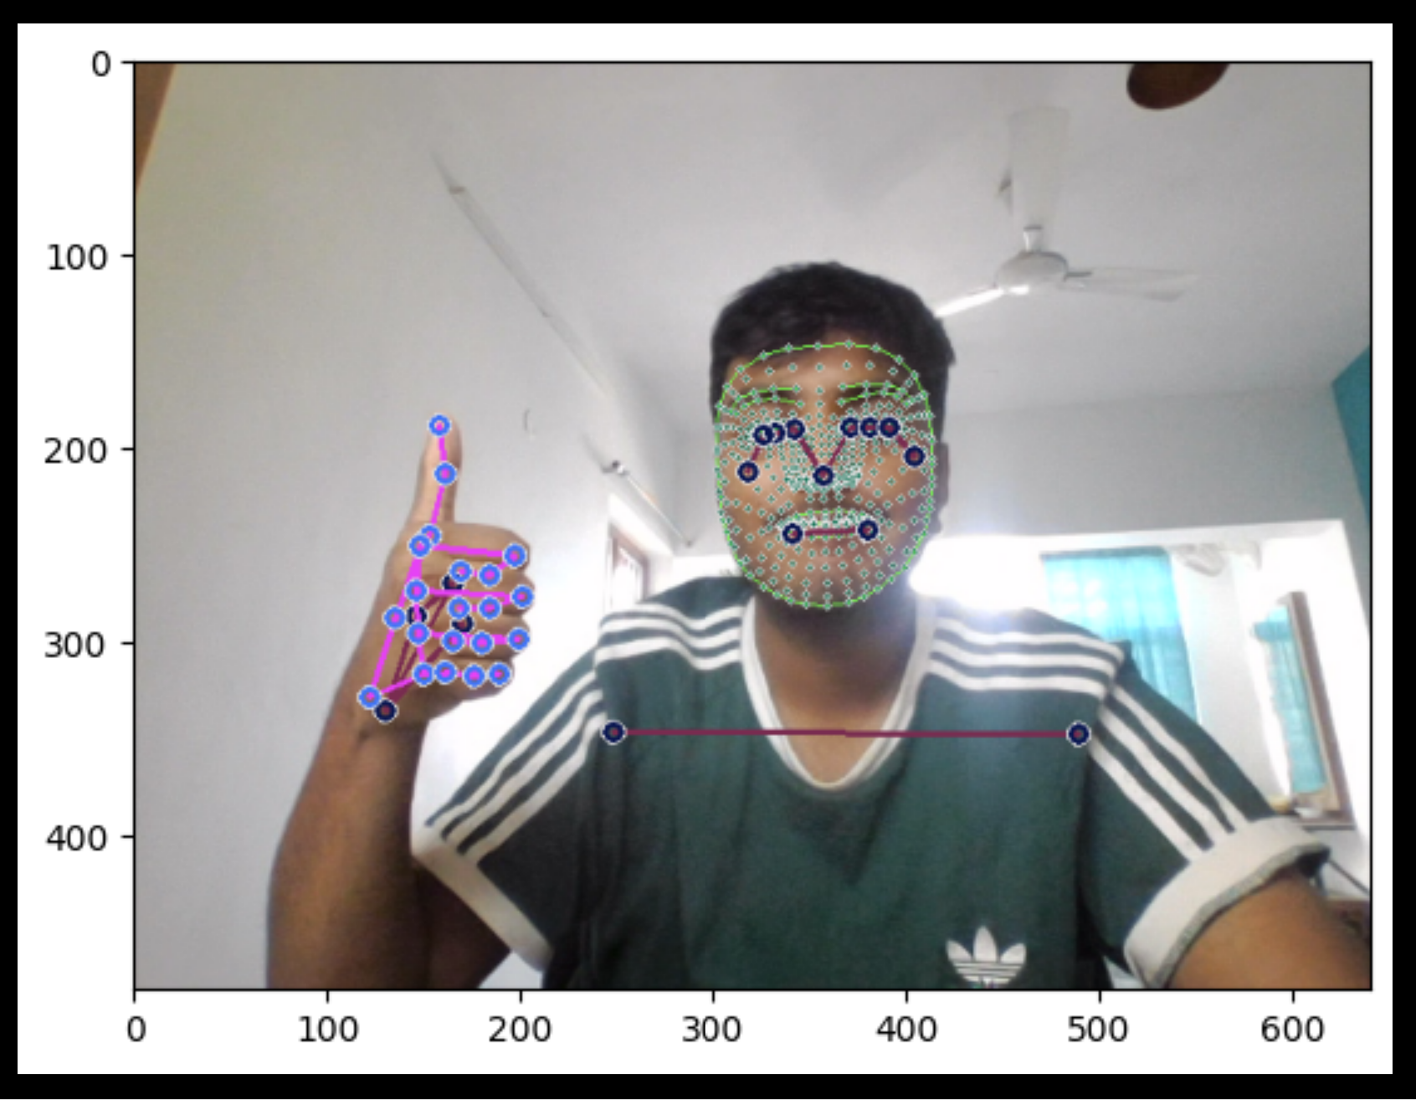
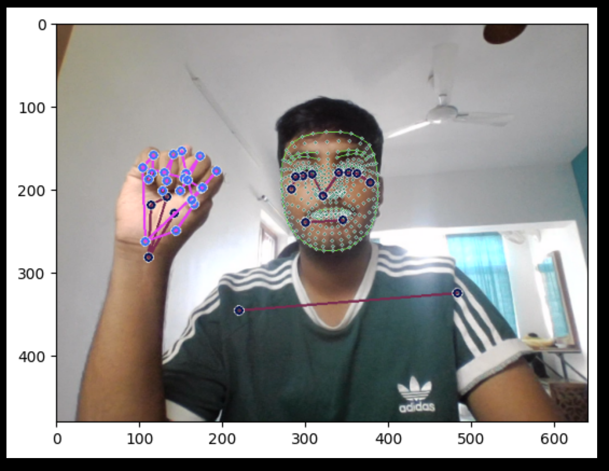
lABELS
GOOD
NEWS

Slide 7
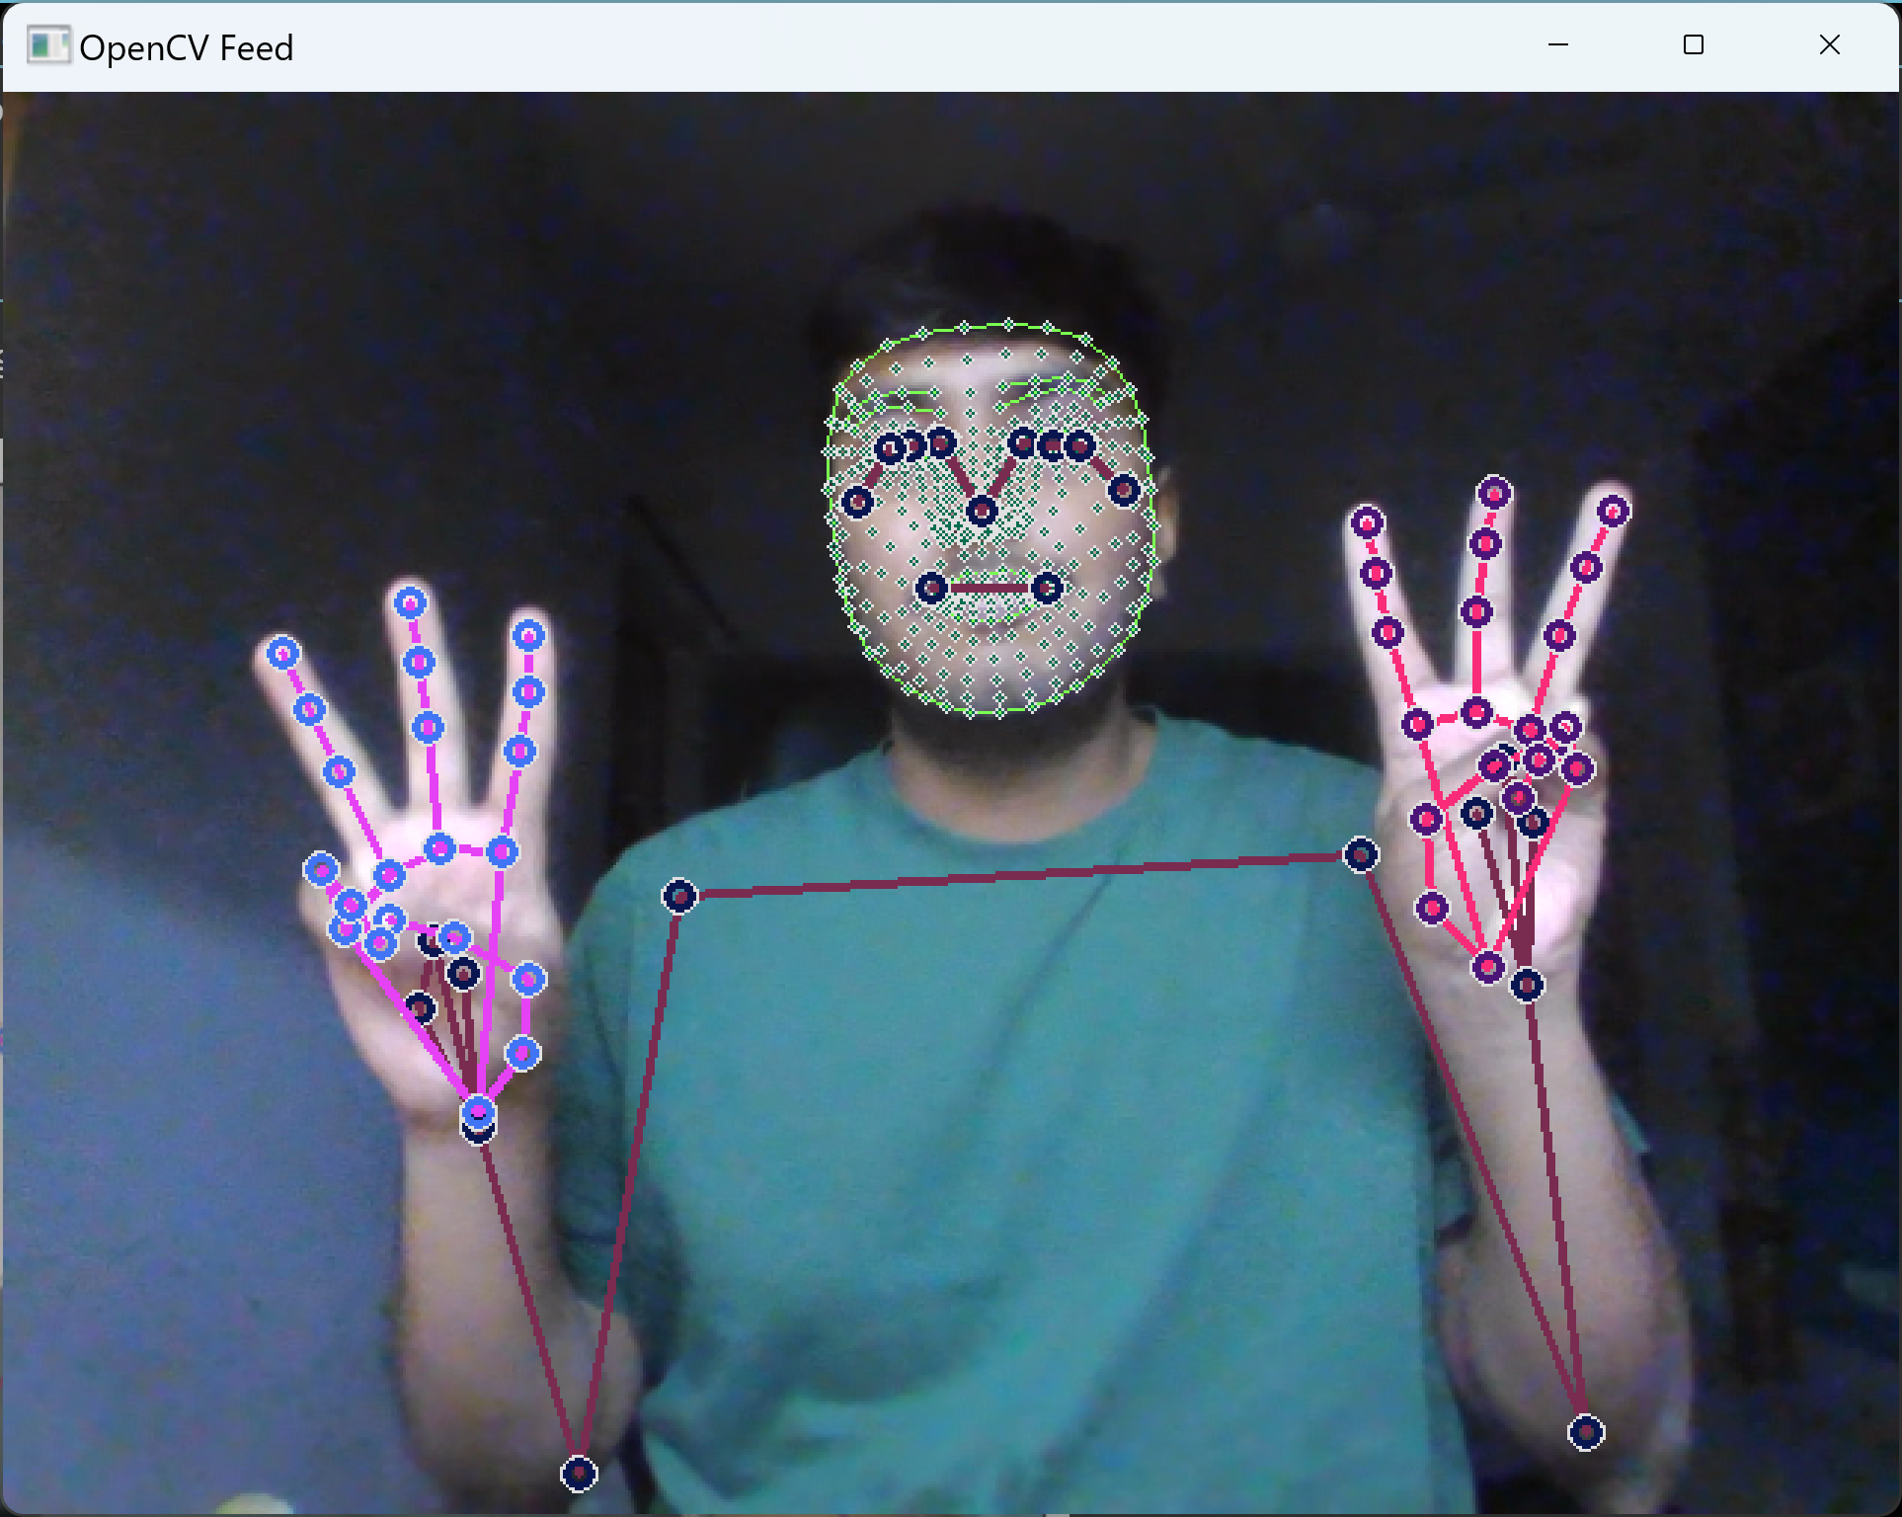
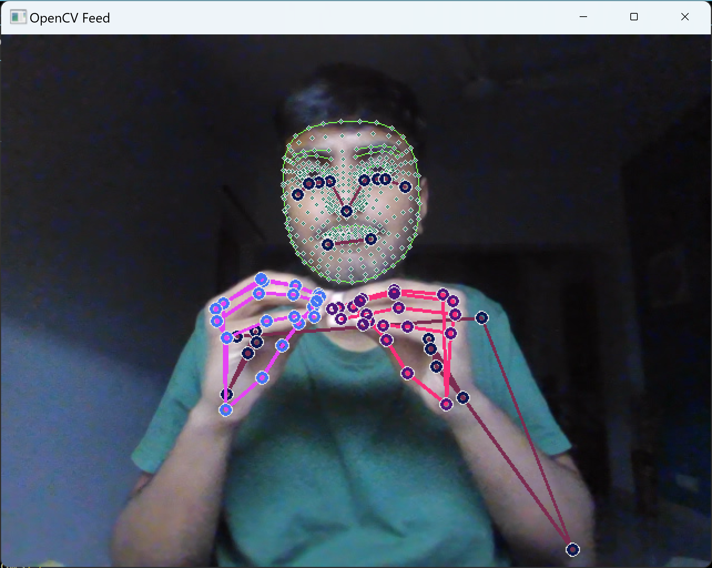
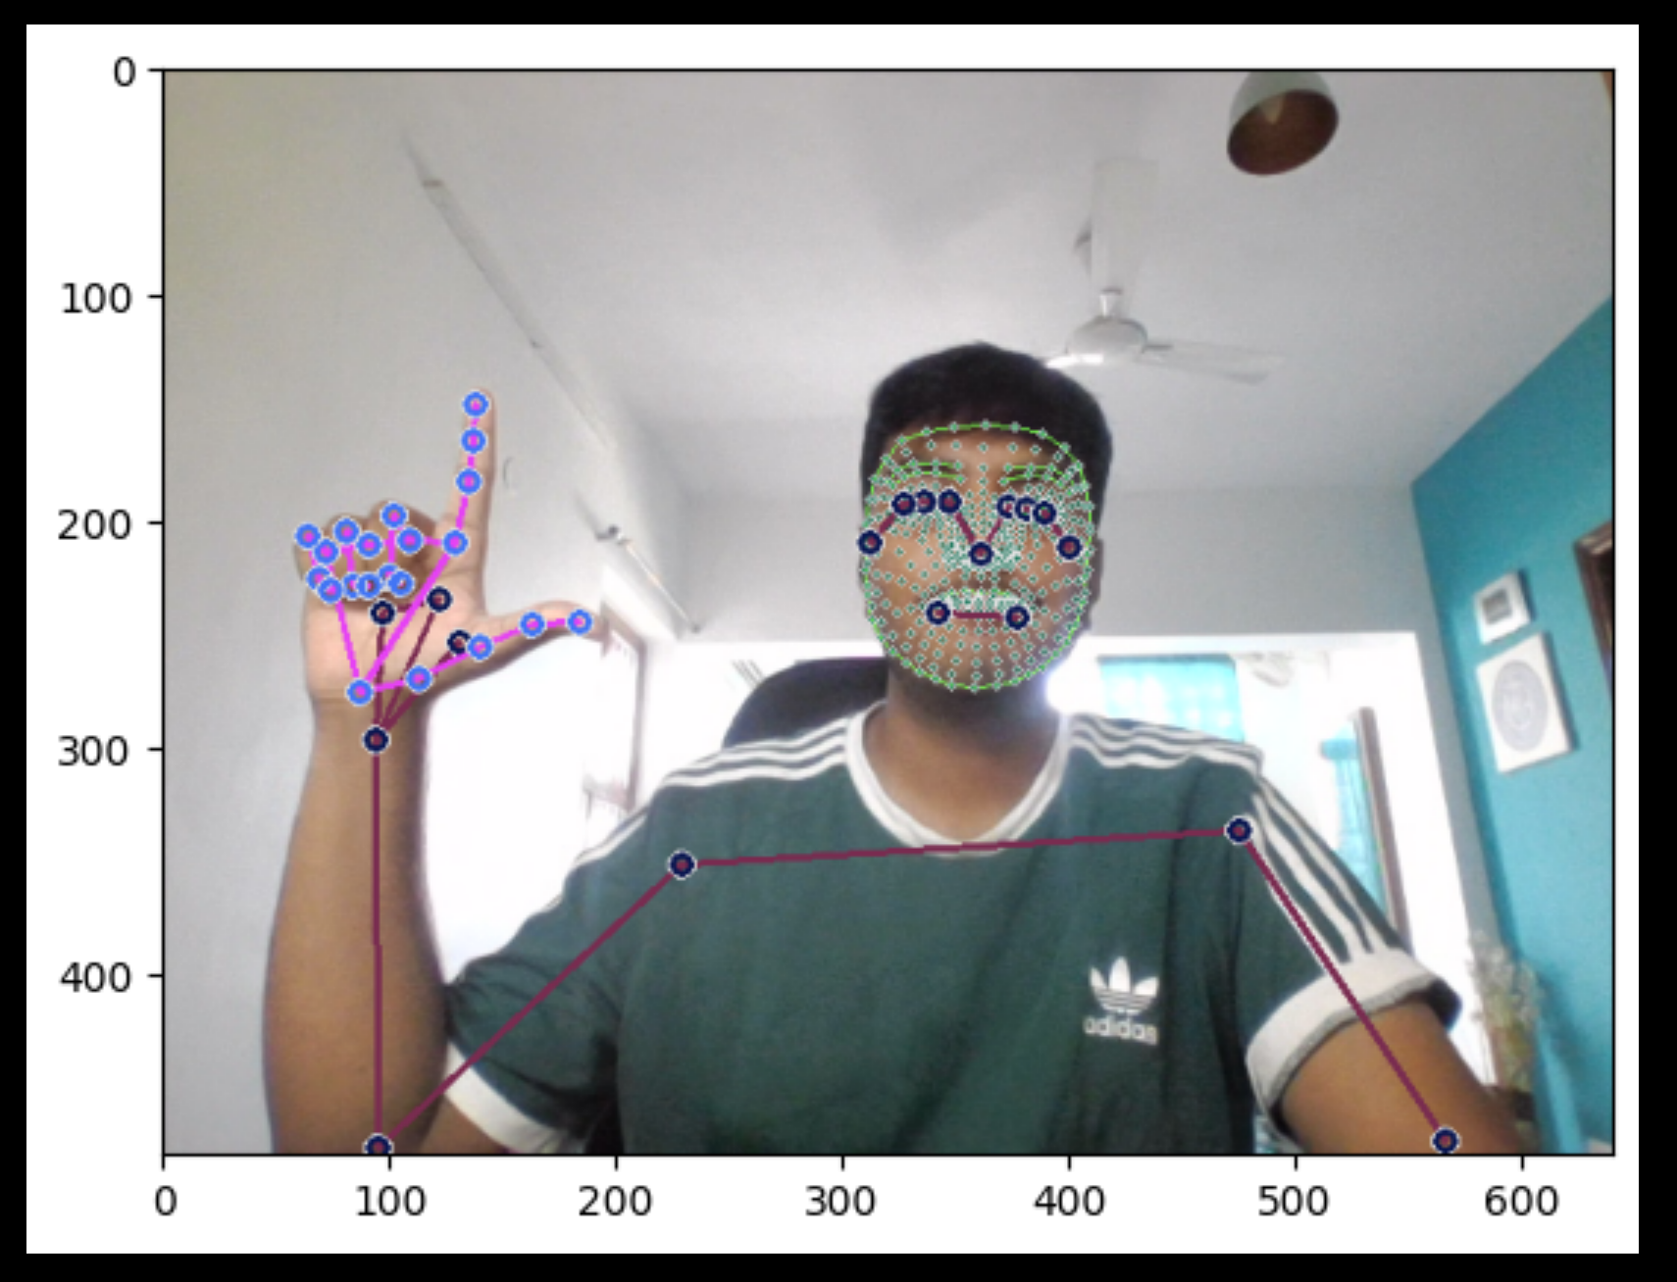
LABELS
WEATHER
IN BOMBAY
IN LONDON

Slide 8
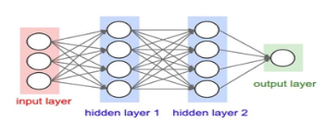
TENSORFLOW nEURAL nETWORK
The Feed forward Neural network in this model was made using TensorFlow ML library.
The Neural network is of a Sequential form due to it being a linear stack of layers.
The model was trained using three Long short-term memory(LSTM) layers and three dense layer networks
The three models have 64,128 and 64 nodes for more thorough ML.

Slide 9
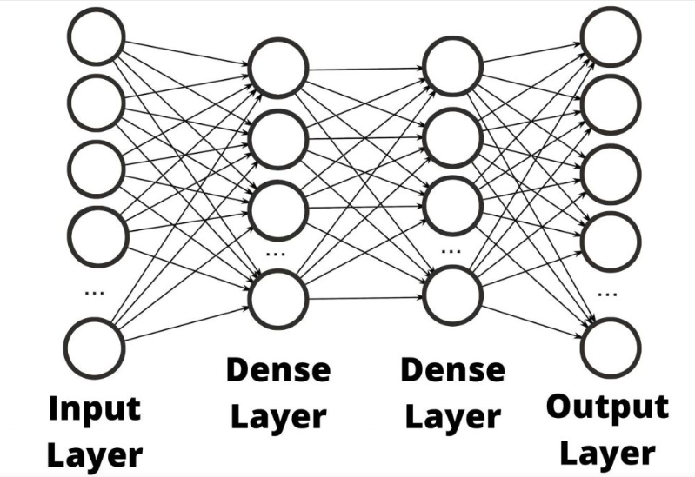
LSTM and DENSE Layers
A long short-term memory (LSTM) layer is a type of recurrent neural network (RNN) layer that can learn long-term dependencies between time steps in time-series and sequence data.
LSTMs have feedback connections, which allow them to process entire sequences of data like a video and , not just single data points like an image.
Dense Layer is simple layer of neurons in which each neuron receives input from all the neurons of previous layer and the dense layer perform matrix-vector multiplication

Slide 10


Functions of chatbot
The Chatbot can do multiple functions like:
- Greeting user: The chatbot is able to greet the user , instantly creating a friendly and engaging interaction
- Weather fetcher: Users can effortlessly retrieve real-time weather updates for any city.
- Top News : The chatbot delivers the latest top 10 news stories, complete with concise descriptions for quick updates.

Slide 11
Chatbot working
The chatbot works on the the basis of Natural Language Programming which is which is a machine learning technology that gives computers the ability to interpret, manipulate, and comprehend human language.
The library that is mainly used in the implementation of NLP in the project is SpaCy .
The tokenizer function in SpaCy makes the input string of the function into tokens. The words of the sentence are made into tokens, and once the token is found in the input a certain function is triggered.
The process user input function gives structure to the code by calling different functions based on if a token is found in the input

Slide 12
How the data is fetched
The News function utilizes API requests to go and fetch data.The website it uses to retrieve data is NewsApi.org for its ease of use and precision.
The website function also utilizes “Request” library to fetch data using API key. For fetching data about the weather we utilize WeatherApi.org

Slide 13
Integration of model and chatbot
Once the main function is called on in the program it triggers the model waiting for a sign-language based input from the user.
After the input from the user the last two labels detected are joined to form a string that is inputted into the chatbot
The chatbot passes the input in through the process user input function and accordingly checks based on token which function is to be called.
Once the particular function is called, it runs function fetches data and displays it on screen

Slide 14
Thank you

